Slide 1
Road Detection
Lakshmi Viswanath

Slide 2
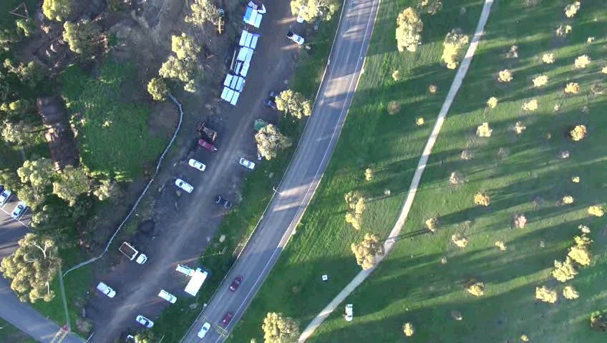
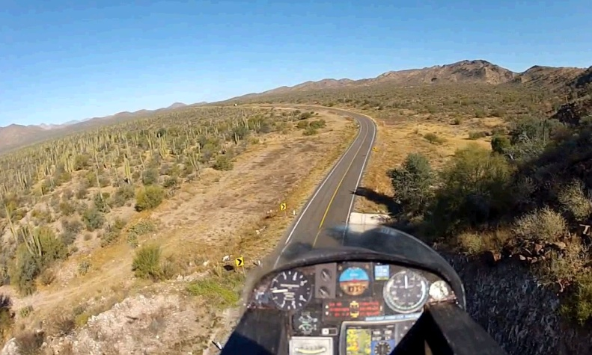
Road Detection
Road Detection plays an important role in automatic navigation, traffic monitoring , ground vehicle tracking and also constructing road networks for modelling and simulation.
We propose a method for detection of a specific road in UAV.
Fig 1: Scenarios with different road colors

Slide 3
An unsupervised algorithm for modeling Gaussian mixtures that is based on the expectation (EM) algorithm and the minimum discription length (MDL) order estimation criteria is proposed.
This algorithm clusters feature vectors to produce a Gaussian mixture model

Slide 4
Proposed Methodology for Road Detection
Gaussian mixture model(GMM) is used to segment road which forms a probabilistic model composed of number of classes.
Each subclass has a set of parameters which are to be estimated from training data of M dimension vector (our methodology M is 3 for RGB color model and 2 for H and V values from HSV color model).
Each Gaussian mixture is described by its - mean vector M for subclass k, - covariance matrix M x M for subclass k and - probability that a pixel has subclass k ( )
Later conditional probability can be found for interest class.

Slide 5
Let be N multispectral pixels obtained from interest class. If for each pixel ,the subclass of pixel ( to be found) then probability density function of a multivariate Gaussian distribution is
Since =k is not known, we use conditional probability and sum over k

Slide 6
For estimating K, Rissanen Minimum Description Length (MDL) is used
For estimating Gaussian parameters , Maximum Likelihood is given by

Slide 7
Algorithm for parameter estimation
Initialize a class(road or non road pixels H V or RGB values from color space) with large number of subclasses say,
Initilize
Apply iterative Expectation-Maximization (EM) algorithm to classify pixels and re-estimate their subclass parameters to obtain parameters until the change in Minimum Description Length(MDL) is less than

Slide 8
re-estimate
Save final GMM parameter values and Minimum Description Length(MDL) value.
The required number of GMM subclasses is 5, so reduce the number of cluster K K-1 by merging 2 subclasses such that distance between any two clusters is less than MDL
and go to step 3.
Stop the process when 5 Gaussians mixture parameters of road or non road pixels is obtained.

Slide 9
Results and Discuission
2 GMM’s (one for road pixels and other for non road pixel) are modelled , each of 5 components. So totally 2x5 GMM components are obtained.
Road and non road pixels are obtained by scratching an image where road segment and non road segments are in image. GMM’s are obtained for H and V values of the pixels.
H(Hue) and V(Value) components from HSV color space of interest image or R ,G and B values from RGB color space is obtained to form a probability model by GMM’s.
Proposed method works for UAV images.

Slide 10
RGB color space road segmentation results

Slide 11
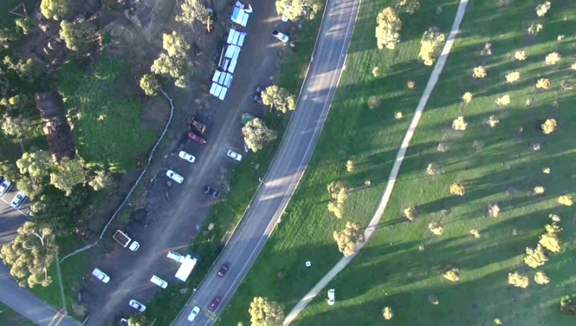
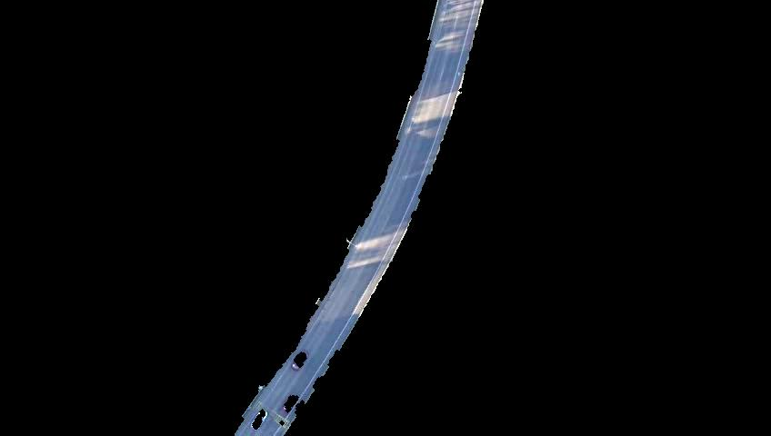

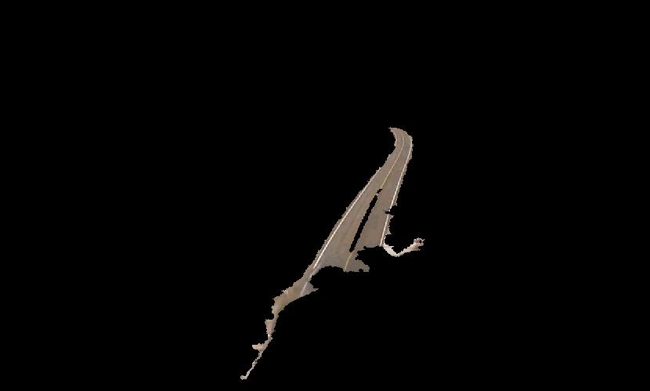
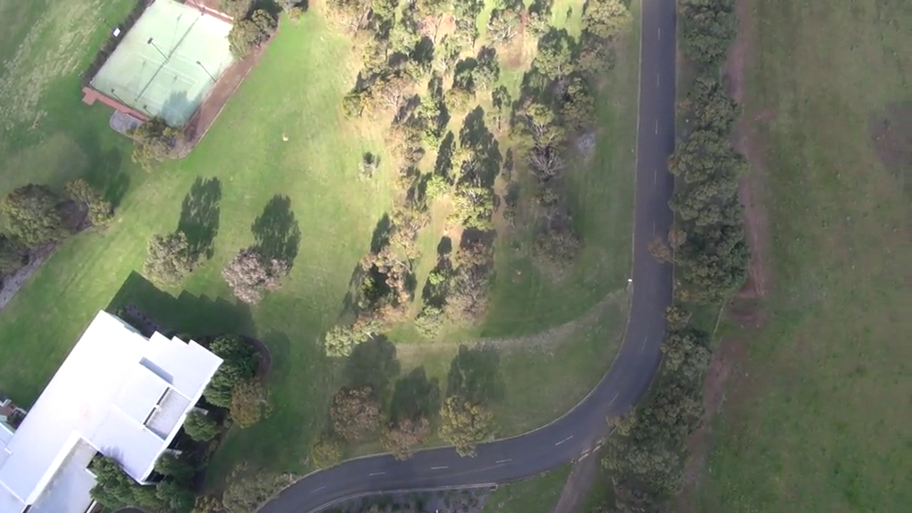
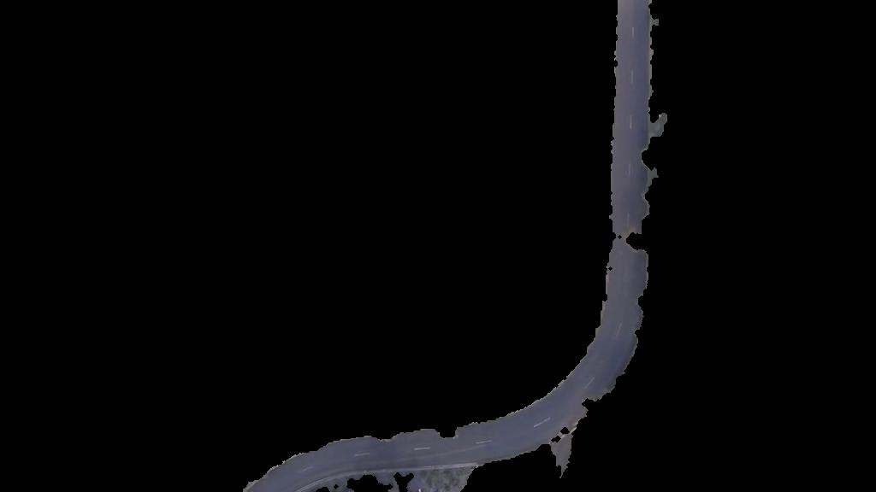
Original Images Segmented and overlaid on original image

Slide 12
H and V values of HSV color space road segmentation results

Slide 13
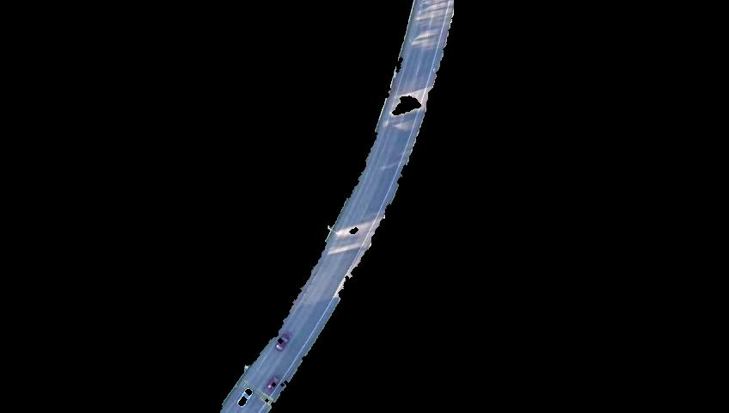
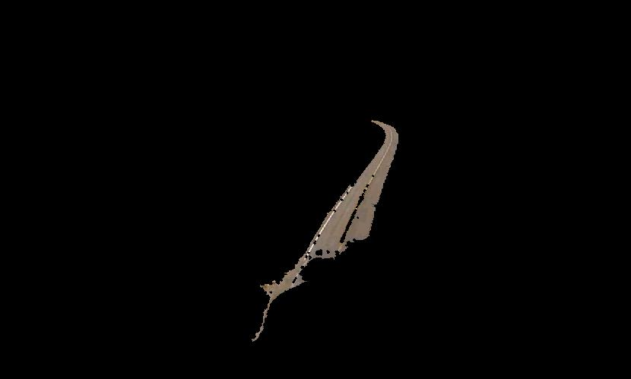

Original Images Segmented and overlaid on original image

